Slide 1
Educational Game for VR
Developed and Presented by Donald Brant, Alan Lam, & Jose Romero
Notes:
Hello. I’m Donald Brant and here with me are my team members Alan Lam and Jose Romero. For our project we’ve set out to develop an educational game for VR.

Slide 2
Project Goals
Develop an immersive, educational PC VR experiences
Provide educational tutorials to teach life skills such as cooking and car maintenance
Provide a simple method for reviewing flashcards in VR
Notes:
Our main goal with this project is to develop an educational tool that leverages VR’s strength of immersion in order to create a fun and engaging learning experience for our users.
To that end we’re creating directed tutorials that walk users through learning life skills such as cooking and performing simple car maintenance.
We’re also developing a flashcard mode that aims to provide a traditional flashcard review experience with digital convenience.

Slide 3



Technologies Used
Notes:
We’ve built our game in Unity, an extremely popular multiplatform game engine used in a wide range of popular games from Temple Run to Beat Saber.
On top of that we’ve utilized SteamVR integration through the SteamVR Unity plugin which allows us to greatly simplify the process of targeting multiple VR platforms by baking in HMD support for all major VR platforms and abstracting or generalizing controls between those platforms.
Although we’re utilizing SteamVR to allow for maximum platform compatibility, due to some technical issues with the lab’s HTC Vive we’ve only been able to develop with and test on the Oculus Rift.
For 3D models and other assets thus far we’ve been using open licensed assets from Unity, SteamVR, and sites such as Google Poly.

Slide 4
Implemented Flashcard Features
Easy input method for users to create custom flashcards (.csv)
Dynamic ‘Omnicard’ display
Input to allow the user to move onto the next card
Notes:
This sprint we’ve started to implement the flashcard level.
We’ve already implemented a method for user input of custom flashcards which we’re handling through a CSV file in the game directory. Users can simply edit this file with their spreadsheet software of choice, putting the front text for cards in the first column and the back text for cards in the second column.
To display the cards we determined that a stack of n cards in VR would be a bit… cumbersome so we opted for a single card solution that I’ve dubbed the Omnicard. The Omnicard displays the text for one flashcard entry at a time.
Once a user is ready for the next card they can simply press a button and the Omnicard will update.
And here is what that looks like.

Slide 5
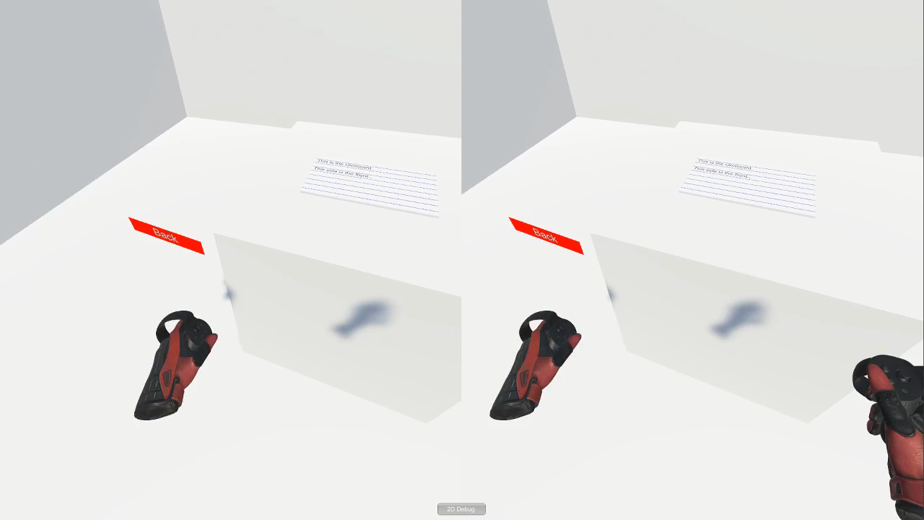

Slide 6
Upcoming Flashcard Features
Card shuffling
Allowing users to mark cards as ‘learned’
Built in flashcard sets associated with the other levels of the game
Notes:
So what we’ve got so far is a pretty simple implementation. We have that instructional text, followed by the custom flashcard entries which just loop forever. Once you reach the last card you return to the first. As we continue to develop this feature we have a few key bits of functionality we’d like to add.
Card shuffling is an obvious next step that will help add challenge and variety to review sessions.
We’d also like to add the ability to mark cards as ‘learned’ to have them removed from the rotation so our users can focus more on the cards that are giving them trouble.
Finally, as we continue to develop our tutorial levels we’d like to create built in flashcard sets to complement those levels.

Slide 7
Menu Features and Player Options
Interactive worldspace menu system
Player height and volume adjustment
Controller button maps
Level selection
Returning to main menu and quitting
Notes:
VR presents some interesting opportunities and challenges when it comes to navigation and player options. Here are some of the approaches we’ve taken to meeting these challenges within our project.
We’ve implement navigation menus within the worldspace allowing players to stay immersed within the virtual spaces they’re inhabiting.
Player height adjustment options have been added, a feature common in most major VR games which helps to insure that players of various heights can reach objects comfortably. Similarly in the name of player comfort, in game volume adjustment has been implemented.
Players also have the option to review the controls for the app from the control menu (accessed from the main menu) and they can of course select their desired level from the main menu as well via the start button.
Finally we’ve implemented a ‘Back’ button within each scene which allows users to return to the main menu as well as a ‘Quit’ button on the main menu which exits the application.

Slide 8
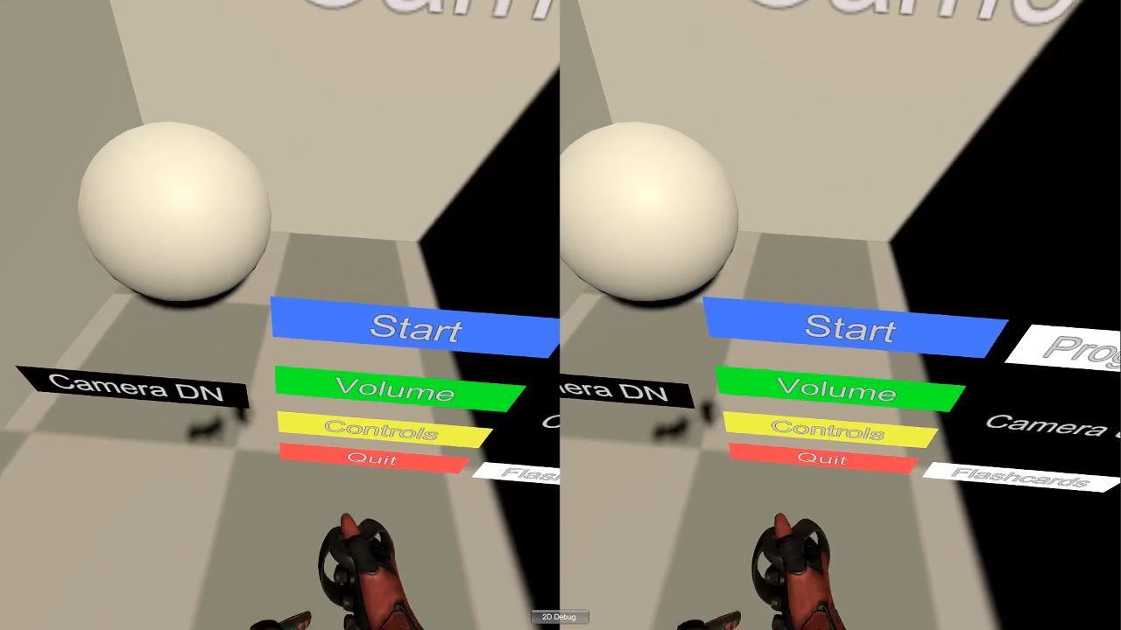

Slide 9
Cooking Tutorial
Notes:
-intro to cooking level (purpose: aid users in learning how to cook in a 3D environment vs watching a video, experience vs watching, etc)
-people can be overwhelmed by cooking, and a walkthrough the basics can help a lot

Slide 10
Cooking Tutorial Current Features
Object to player interactions
Object spawning
Teleportation between fixed points
Object collision
Notes:
In the current build of the project we have implemented an entire level that focuses around the cooking tutorial that we plan to use in order to help people prepare and cook ingredients correctly.
One of the core features of this part of the application was making sure that the player could interact with objects within the world space. To this cause we’ve implemented a way to pick up and throw objects within the world.
Another feature implemented was the process of spawning objects within a world through a button which will ideally spawn ingredients for the player to use. This button can be accessed by teleporting to in front of the fridge another feature that helps the user access certain areas of the level.
Finally we do have object collision so that objects will not pass through one another and fall through the level.

Slide 11
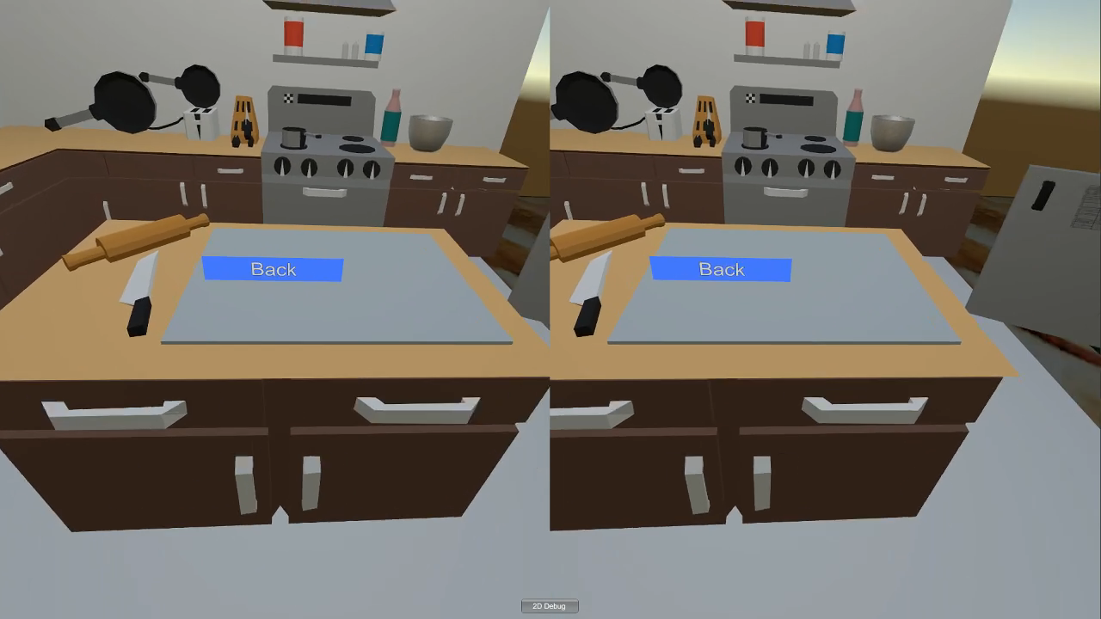

Slide 12
Cooking Tutorial Planned Features
Sorted fridge
More ingredients
Ingredient mixing and preparation
Utensil/cooking tools
A basic tutorial
Notes:
Much of the progress completed within the kitchen level was mostly to get down the base mechanics of the player interacting with both the world and the objects within it. Now that that has been taken care of though we can further flesh out the features and objective that the level is expected to have to function as an actual game.
Besides simply having more ingredients that could expand the total amount of recipes within the game we also plan to have tools in order to prepare the ingredients a certain ways. This can range from knives in order to cut food up, or pots in order to properly boil food.
Another feature we plan to add by the end of the sprint is a fridge that separates ingredients by certain classifications or attributes. This will make it easier for the player to find the ingredients that they want without having a cumbersome amount of buttons appear at once.

